Slide 1
Surface Defects and the BPS Spectrum
of 4d N=2 Theories
Penn Strings-Math, June 11, 2011
Gregory Moore, Rutgers University
Davide Gaiotto, G.M. , Andy Neitzke
Wall-crossing in Coupled 2d-4d Systems: 1103.2598
Framed BPS States: 1006.0146
Wall-crossing, Hitchin Systems, and the WKB Approximation: 0907.3987
Four-dimensional wall-crossing via three-dimensional Field theory: 0807.4723

Slide 2
A Motivating Question
Given an arbitrary four-dimensional field theory with N=2 supersymmetry, is there an algorithm for computing its BPS spectrum?
A basic question, and a good litmus test to see how well we understand these theories…
We describe techniques which should lead to such an algorithm for
``A_{k} theories of class S’’

Slide 3
Outline
1. Review of some N=2,d=4 theory
2. Theories of Class S
6d (2,0) and cod 2 defects
Compactified on C
Related Hitchin systems
BPS States and finite WKB networks
3. Line defects and framed BPS States
4. Surface defects
UV and IR
Canonical surface defects in class S
2d4d BPS + Framed BPS degeneracies
5. 2d/4d WCF
6. Algorithm for theories of class S
Overview of results on hyperkahler geometry

Slide 4
Preliminaries: 1/4
1
Basic Data:
Special Kahler manifold , the ``Coulomb branch.’’
Local system of lattices Γ -> , equipped with integral antisymmetric form.

Slide 5
Preliminaries: 2/4
Charges of unbroken flavor symmetries
Symplectic lattice of (elec,mag) charges of IR abelian gauge theory

Slide 6
Self-dual IR abelian gauge field

Slide 7
Preliminaries:3/4 BPS States and Indices

Slide 8
Seiberg-Witten Moduli Space
Hyperkahler target space of 3d sigma model from compactification on R³ x S¹
Seiberg & Witten

Slide 9
The six-dimensional theories
Claim, based on string theory constructions:
There is a family of stable field theories, T[k] with six-dimensional (2,0) superconformal symmetry, and certain characterizing properties. They are not free field theories for k>1. (Witten; Strominger; Seiberg).
These theories have not been constructed – even by physical standards - but the characterizing properties of these hypothetical theories can be deduced from their relation to string theory and M-theory.
These properties will be treated as axiomatic. Later they should be theorems.
Related free field theories with six-dimensional (2,0) superconformal symmetry can be rigorously constructed – although this has not been done in full generality, and itself presents some nontrivial issues in topology and physics.

Slide 10
The theory is defined on oriented spin 6-folds with integral lift of w₄ and is valued in a 7D topological field theory.
On R⁶ there is a moduli space of vacua (R^{k} x R⁵)/S_{k}
The low energy dynamics around points on this moduli space are described by abelian tensormultiplets valued in u(k).
In addition there are finite tension strings, charged under the abelian tensormultiplets, with charges given by roots of u(k)
There are so(5) multiplets of chiral BPS operators of dimensions given by the exponents of u(k)
There are supersymmetric defects labeled by (, ). In the IR, far out on the moduli space of vacua these are well-approximated by a sum over the weights of  of the B-field holonomy + supersymmetrizing terms.
There are half-BPS codimension two defects with nontrivial global symmetries. They induce half-BPS boundary conditions on maximal SYM theory in 5 and 4 dimensions.

Slide 11
Theories of Class S
2
Consider nonabelian (2,0) theory T[g] for ``gauge algebra’’ g
The theory has half-BPS codimension two defects D(m)
Compactify on a Riemann surface C with D(m_{a}) inserted at punctures z_{a}
Twist to preserve d=4,N=2
Witten, 1997
GMN, 2009
Gaiotto, 2009

Slide 12
Seiberg-Witten = Hitchin
5D g SYM
σ-Model:

Slide 13
Digression: Puncture Zoo
Regular singular points:
Irregular singular points:
Physics depends on the closure of the G_{c} orbit of:

Slide 14
Seiberg-Witten Curve
SW differential
For g= su(k)
is a k-fold branch cover

Slide 15
Local System of Charges
determines
A local system over a torsor for spaces of holomorphic
differentials…

Slide 16
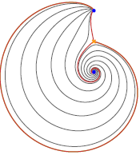
BPS States: Geometrical Picture
BPS states come from open M2 branes stretching between sheets i and j. Here i,j, =1,…, k. This leads to a nice geometrical picture with string networks:
Klemm, Lerche, Mayr, Vafa, Warner; Mikhailov; Mikhailov, Nekrasov, Sethi,
Def: A WKB path on C is an integral path
Generic WKB paths have both ends on singular points z_{a}

Slide 17
Finite WKB Networks – 1/3
But at critical values of ϑ=ϑ* ``finite WKB networks appear’’:
Hypermultiplet

Slide 18
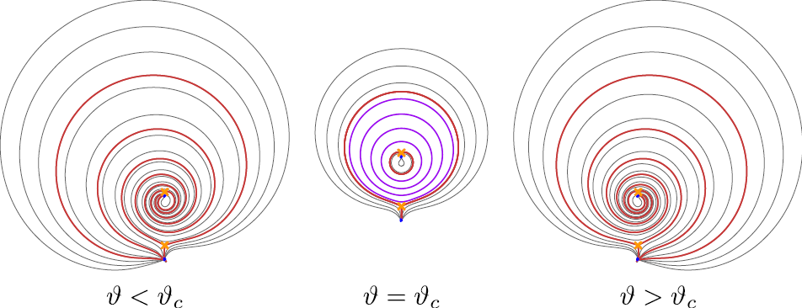
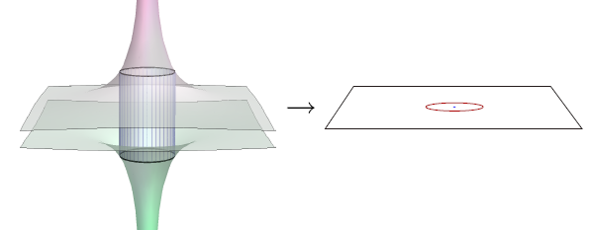
Finite WKB Networks – 2/3
Closed WKB path
Vectormultiplet

Slide 19
Finite WKB Networks – 3/3
At higher rank, we get string networks at critical values
of ϑ:
A ``finite WKB network’’ is a union of WKB paths with endpoints on branchpoints or such junctions.
These networks lift to closed cycles γ in Σ and represent BPS states with

Slide 20
Line Defects & Framed BPS States
3
A line defect (say along R_{t} x {0 } ) is of type ζ if it preserves the susys:
Example:

Slide 21
Framed BPS States saturate this bound, and have framed protected spin character:
Piecewise constant in ζ and u, but has wall-crossing
across ``BPS walls’’ (for Ω(γ)≠ 0):
Particle of charge γ binds to the line defect:
Similar to Denef’s halo picture

Slide 22
Wall-Crossing for
Across W(γ_{h}) Denef’s halo picture leads to:
constructed from

Slide 23
Wall-Crossing for
Consistency of wall crossing of framed BPS states implies the Kontsevich-Soibelman ``motivic WCF’’ for
We simply compare the wall-crossing associated to two different paths relating <F(L)>(u₁,ζ₁) and <F(L)(u₂,ζ₂)
The KSWCF is really a statement that a certain connection on  x C* is flat.

Slide 24
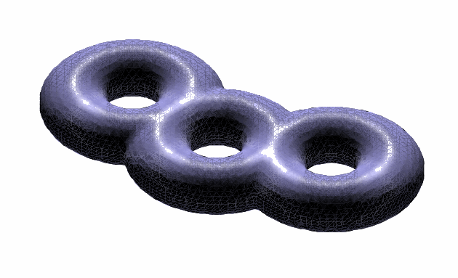
Line defects in T[g,C,m]
6D theory T[g] has supersymmetric
surface defects S(, σ )
For T[g,C,m] consider
Line defect in 4d labeled by isotopy class of a closed path ℘ and 
k=2:
Drukker, Morrison,
Okuda

Slide 25
Complex Flat Connections
(A,φ ) solve Hitchin equations iff
is a complex flat connection on C
On R³ x S¹ line defects become local operators in the 3d sigma model:
= holomorphic function on M

Slide 26
Surface defects
4
Preserves d=2 (2,2) supersymmetry subalgebra
Twisted chiral multiplet :
IR DESCRIPTION
Finite set of vacua

Slide 27
Effective Solenoid
α,η ARE NOT
QUANTIZED

Slide 28
Torsor of Effective Superpotentials
A choice of superpotential =
a choice of gauge =
a choice of flux γ_{i}
Extends the central charge to a Γ - torsor Γ_{i}

Slide 29
Canonical Surface Defect in T[g,C,m]
For z ∈ C we have a canonical surface defect S_{z}
It can be obtained from an M2-brane ending at x¹=x²=0 in R⁴ and z in C
In the IR the different vacua for this M2-brane are the different sheets in the fiber of the SW curve over z.
Therefore the chiral ring of the 2d theory should be the same as the equation for the SW curve!
Alday, Gaiotto, Gukov, Tachikawa, Verlinde; Gaiotto

Slide 30
Example of SU(2) SW theory
Chiral ring of the CP¹ sigma model.
2d-4d instanton effects
Twisted mass
Gaiotto

Slide 31
Superpotential for S_{z} in T[g,C,m]
x_{i}
x_{j}
z
NEED TO JUSTIFY
Homology of an open path on Σ joining x_{i} to x_{j} in the fiber over S_{z}

Slide 32
New BPS Degeneracies: μ
2D soliton degeneracies.
Flux:
For S_{z} in T[su(k),C,m], μ is a signed sum of open finite BPS networks ending at z

Slide 33
New BPS Degeneracies: ω
Flux:
Degeneracy:

Slide 34
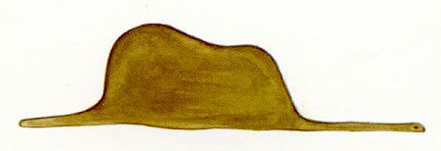
Supersymmetric Interfaces: 1/2
UV:
IR:
Flux:

Slide 35
Supersymmetric Interfaces: 2/2
Our interfaces preserve two susy’s of type ζ and hence we can define framed BPS states and form:

Slide 36
Susy interfaces for T[g,C,m]:1/2
Interfaces between S_{z} and S_{z’} are labeled by open paths ℘ on C
So: framed BPS states are graded by open paths γ_{ij’} on Σ with endpoints over z and z’

Slide 37
Susy interfaces for T[g,C,m]:2/2
Wrapping the interface on a circle in R³ x S¹ compactification:

Slide 38
Framed BPS Wall-Crossing
Across BPS W_{γ} walls the framed BPS degeneracies undergo wall-crossing.
Now there are also 2d halos which form across walls
As before, consistency of the wall-crossing for the framed BPS degeneracies implies a general wall-crossing
formula for unframed degeneracies μ and ω.

Slide 39
Framed Wall-Crossing for T[g,C,m]
WE CAN ALSO STUDY WC IN z:
The separating WKB paths of phase ζ on C are the BPS walls for

Slide 40
Formal Statement of 2d/4d WCF
5
Four pieces of data
Three definitions
Statement of the WCF
Relation to general KSWCF
Four basic examples

Slide 41
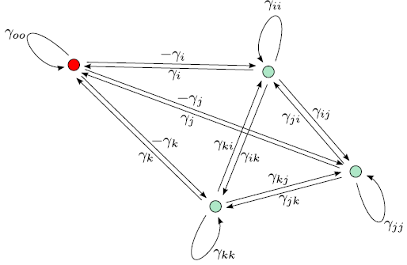
2d-4d WCF: Data
A. Groupoid of vacua, V : Objects = vacua of S:
i = 1,…, k & one distinguished object 0. Morphism spaces are torsors for Γ, and the automorphism group of any object is isomorphic to Γ:

Slide 42
2d-4d WCF: Data
B. Central charge Z ∈ Hom(V, C) :
Here a, b are morphisms γ γ_{i} γ_{ij} ; valid when the composition of morphisms a and b, denoted a+b, is defined.
&
C. BPS Data:
D. Twisting function:
when a+b is defined

Slide 43
2d-4d WCF: 3 Definitions
A. A BPS ray is a ray in the complex plane:
IF
IF
B. The twisted groupoid algebra C[V]:

Slide 44
2d-4d WCF: 3 Definitions
C. Two automorphisms of C[V]:
CV-like:
KS-like:

Slide 45
2d-4d WCF: Statement
Fix a convex sector:
The product is over the BPS rays in the sector, ordered by the phase of Z
WCF:
is constant as a function of Z, so long as no BPS line enters or leaves the sector

Slide 46
Four ``types’’ of 2d-4d WCF-A
A. Two 2d – central charges sweep past each other:
Cecotti-Vafa

Slide 47
Four ``types’’ of 2d-4d WCF - B
B. Two 4d – central charges sweep past each other:

Slide 48
Four ``types’’ of 2d-4d WCF - C
C. A 2d and 4d central charge sweep past each other:

Slide 49
Four ``types’’ of 2d-4d WCF - D
D. Two 2d central charges sweep through a 4d charge:

Slide 50
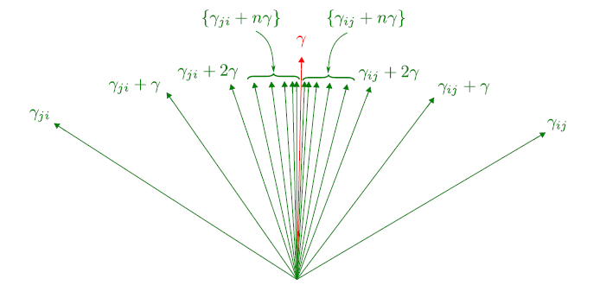

Slide 51
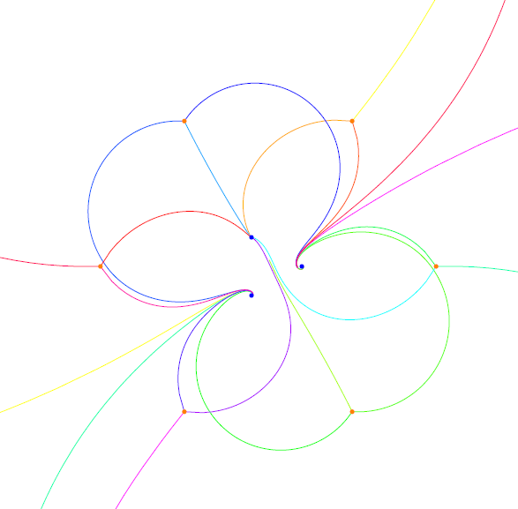
The Algorithm
6
Fix a phase ϑ . On the UV curve C draw the separating WKB paths of phase ϑ : These begin at the branch points but end at the singular points (for generic ϑ ) :
A
Massive Nemeschansky-Minahan E₆ theory,
realized as a trinion theory a la Gaiotto.

Slide 52
B
Label the walls with the appropriate S^{μ} factors – these are easily deduced from wall-crossing.
Now, when a ij-line intersects a jk-line, new lines are created. This is just the CV wall-crossing formula SSS = SSS.

Slide 53
C:
Iterate this process.
Conjecture: It will terminate after a finite number of steps (given a canonical structure near punctures).
Call the resulting structure a ``minimal S-wall network’’ (MSWN)
D:
Now vary the phase ϑ.
This determines the entire 2d spectrum
for all

Slide 54
The MSWN will change isotopy class precisely when an S-wall sweeps past a K-wall in the ζ- plane. Equivalently, when an (ij) S-wall collides with an (ij) branch point:

Slide 55
E:
Finally, use the 2d/4d WCF to determine the 4d BPS spectrum:

Slide 57
Concluding slogan for this talk
The 2D spectrum
controls
the 4D spectrum.

Slide 58
Spectrum Generator?
Can we work with just one ζ ?
Perhaps yes, using the notion of a ``spectrum generator’’ and ``omnipop’’
This worked very well for T[su(2),C,m] to give an algorithm for computing the BPS spectrum of these theories.
Very recently: We have made this work and have an algorithm for the BPS spectrum of A_{k} theories of class S.

Slide 59
Hyperkahler Summary - A
Hyperkahler geometry: A system of holomorphic Darboux coordinates for SW moduli spaces can be constructed from a TBA-like integral equation, given Ω.
1.
From these coordinates we can construct the HK metric on .
2.
3.

Slide 60
Hyperkahler Summary - B
For T[su(2),C,m], _{γ} turn out to be closely related to Fock-Goncharov coordinates
4.
We are currently exploring how the coordinates for T[su(k),C,m] are related to the ``higher Teichmuller theory’’ of Fock & Goncharov
5.

Slide 61
Hyperkahler Summary - C
6.
For T[su(2),C,m] the analogous functions:
associated to
are sections of the universal bundle over , and allow us moreover to construct hyper-holomorphic connections on this bundle.
7.
Explicit solutions to Hitchin systems
(a generalization of the inverse scattering method)

